Slide 1

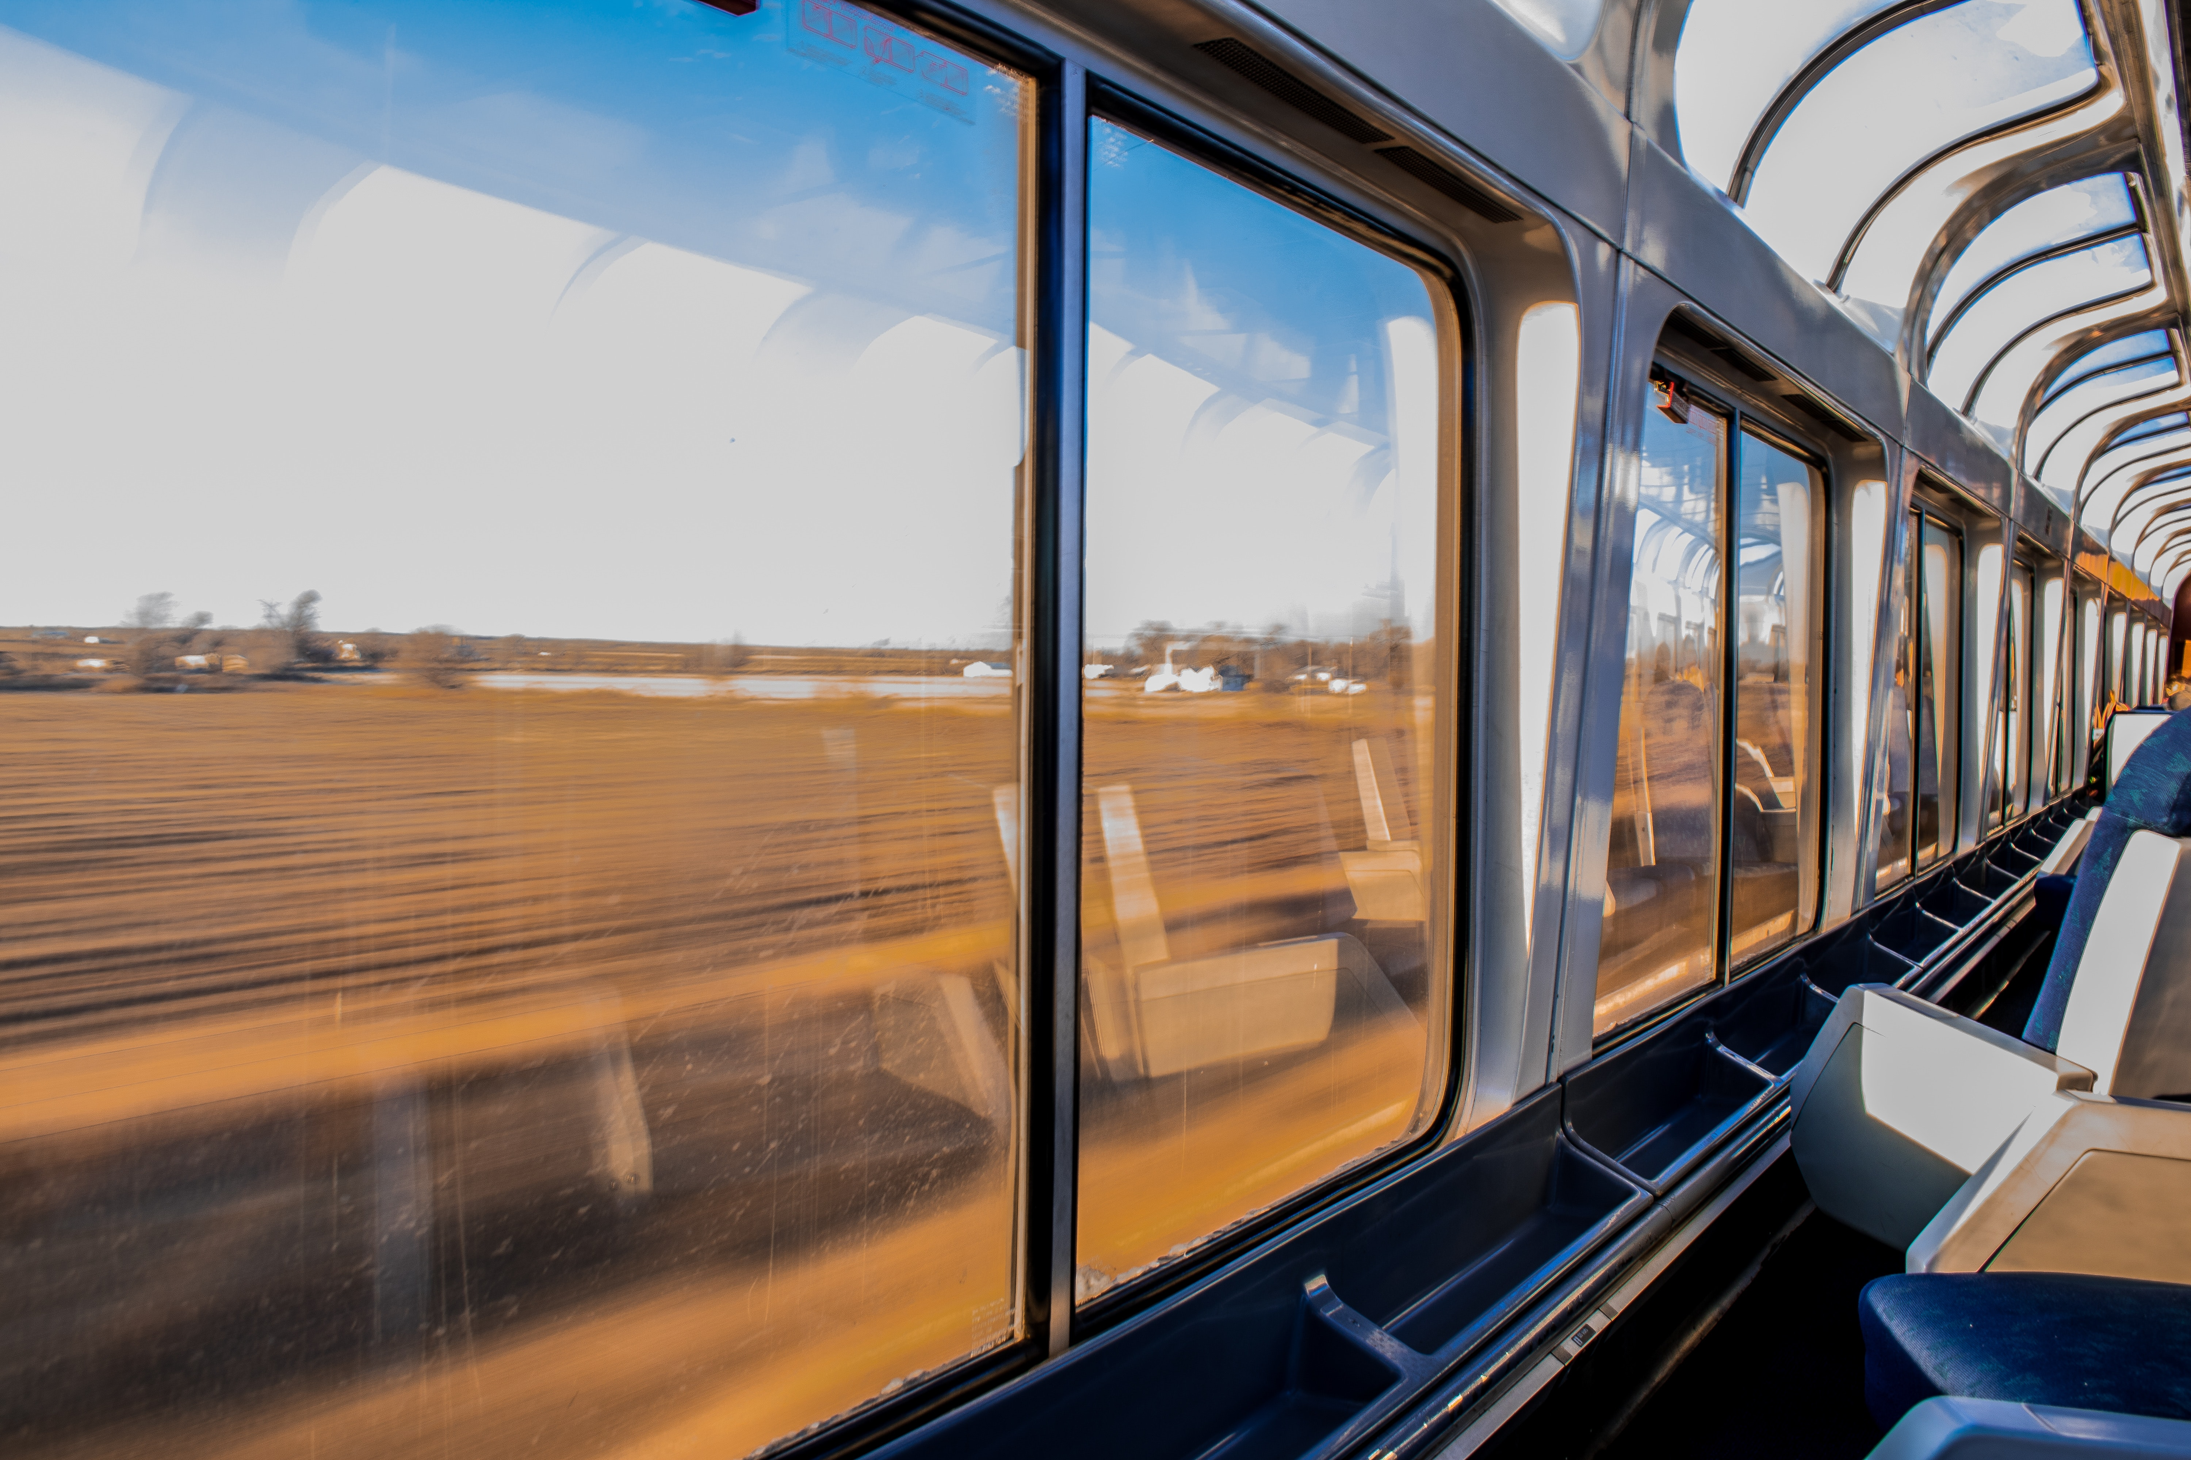
WELCOME
Train Ticket Reservation System

Slide 2






Contents
Team Details
Business Requirements
Graphical Representation
Tools and Technologies
Screenshots
Conclusion

Slide 3




Group - D
TEAM DETAILS
Lavanya
Kanupuru
UI Design
MySQL Developer
Venu
Chennamsetty
UI Design
Java Developer
Shwetha Nagesh
UI Design
MySQL Developer
Deepak Muvvala
UI Design
Java Developer

Slide 4
Business Requirement
The trains should be fetched from database using train number or location
Travel date of date should be after current date
Ticket fare for each passenger is calculated based on business requirements
Admin can add, update and delete trains as per their availability.

Slide 5
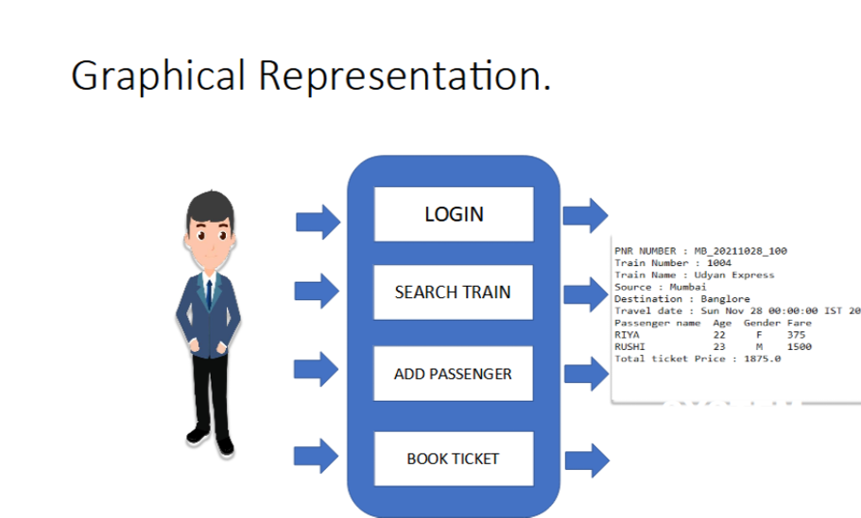

Slide 6
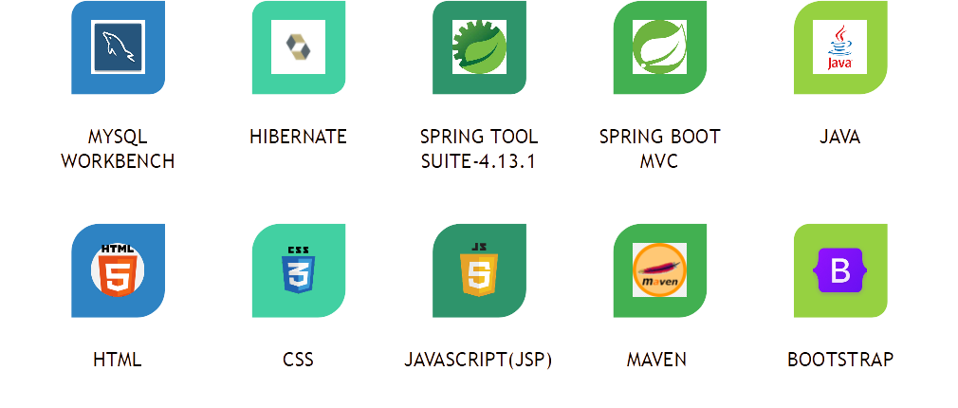


TOOLS AND TECHNOLOGIES
AWS
Docker

Slide 7
Screenshots

Slide 8
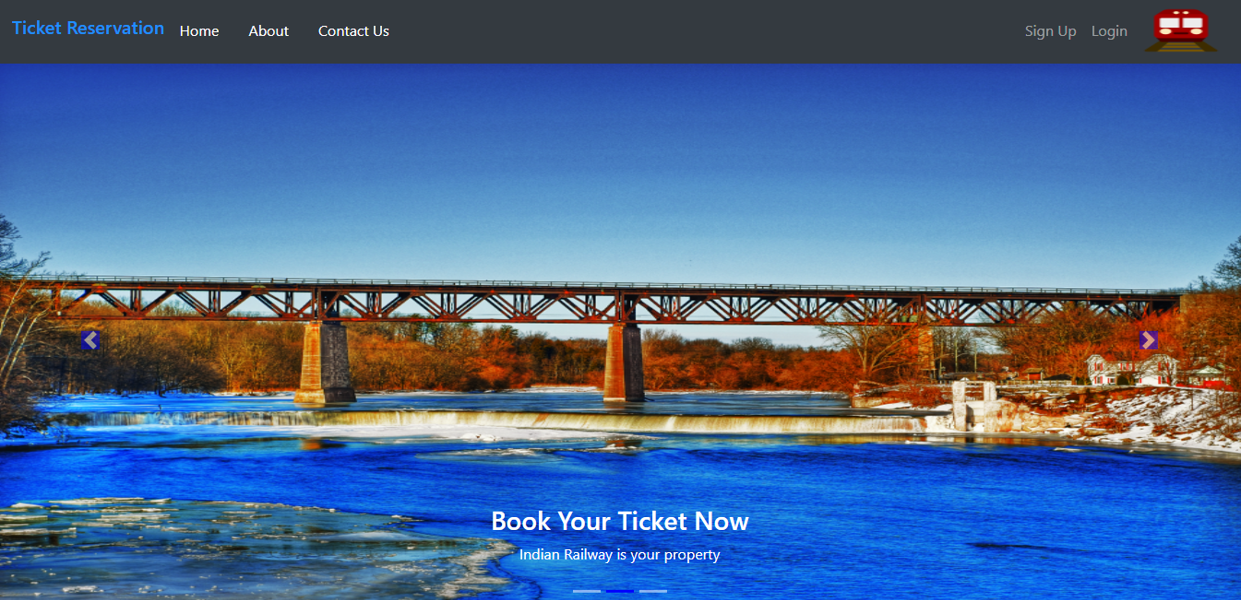
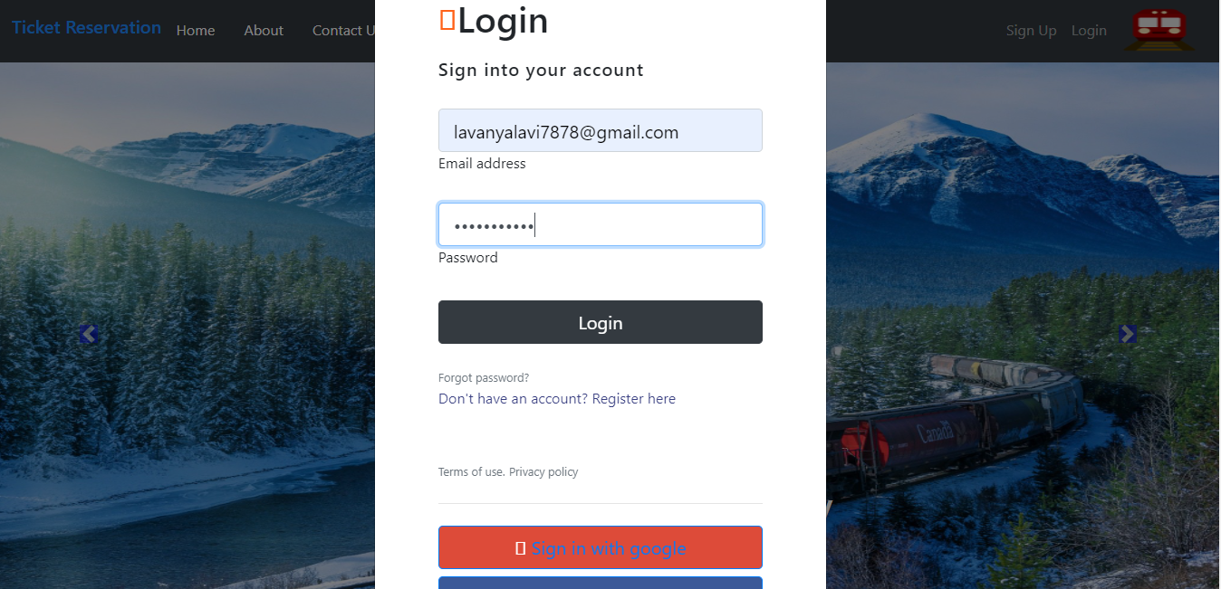
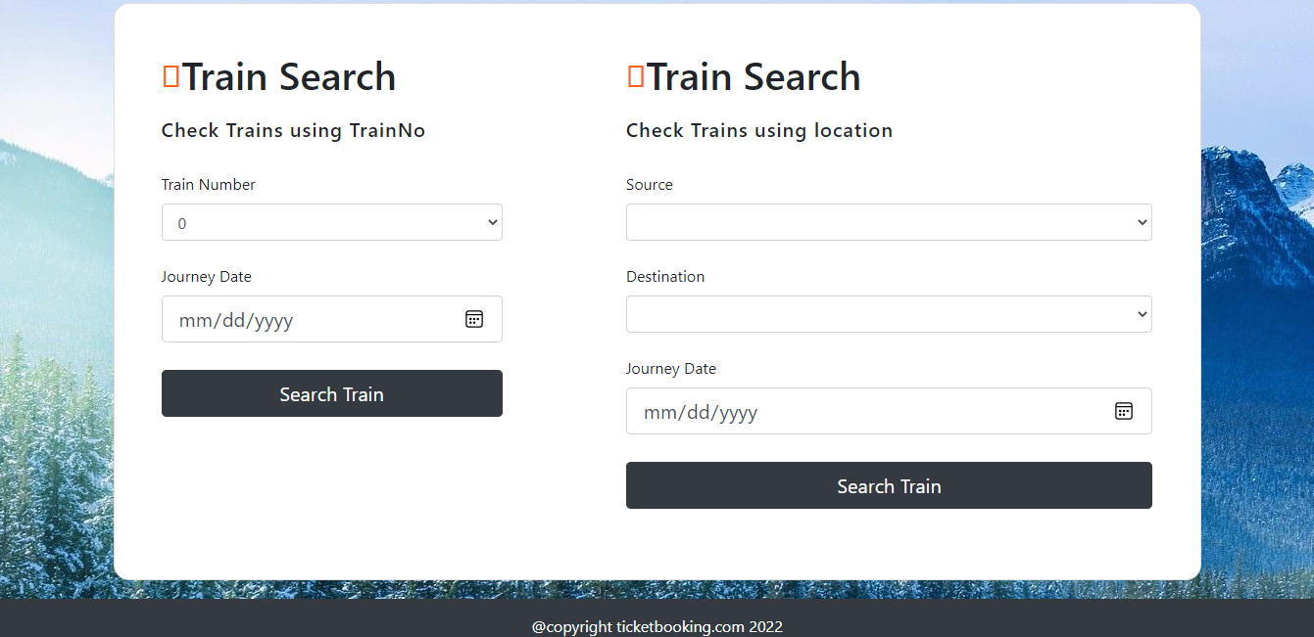
Home Page
Login Page
Train Search

Slide 9
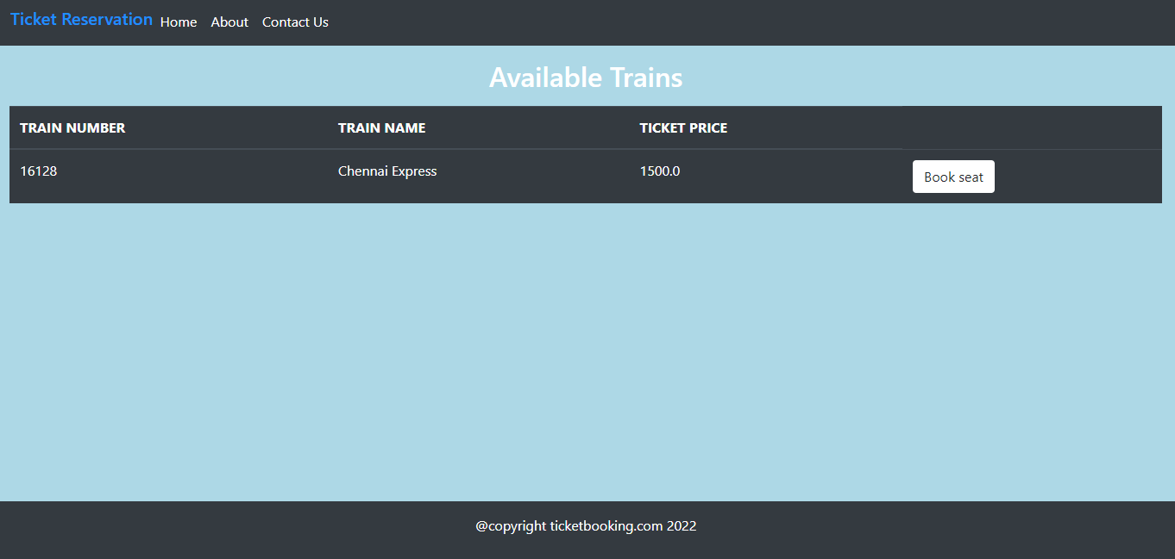
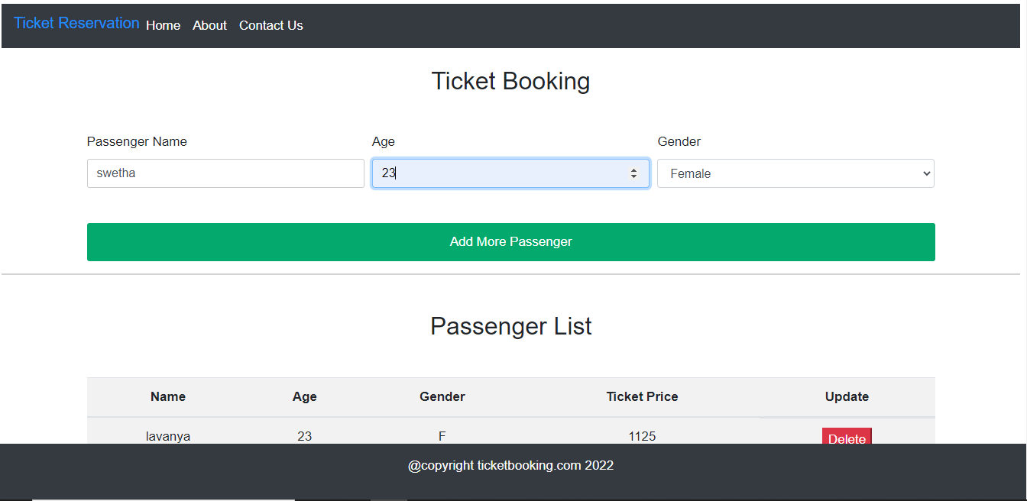
Available Trains
Ticket Booking

Slide 10
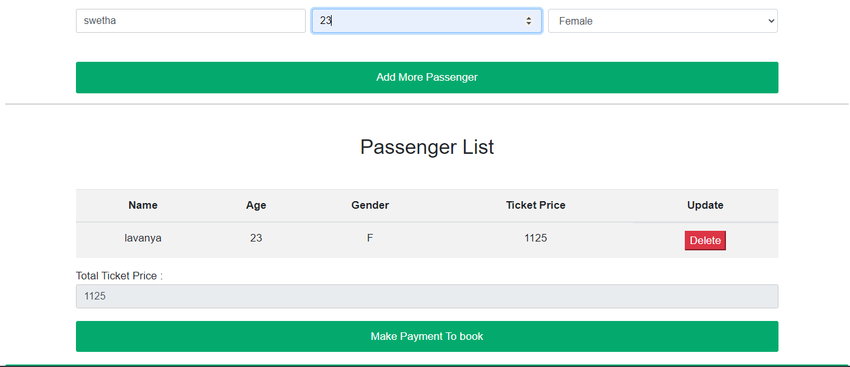
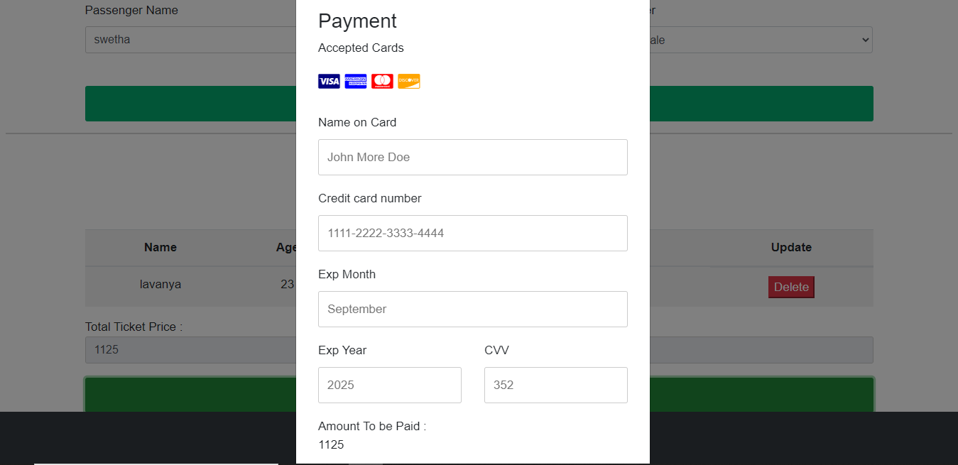
Passenger List
Payment

Slide 11
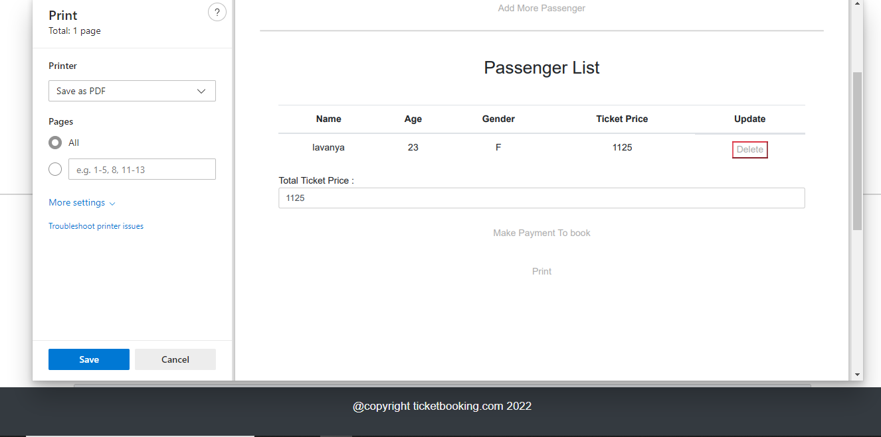
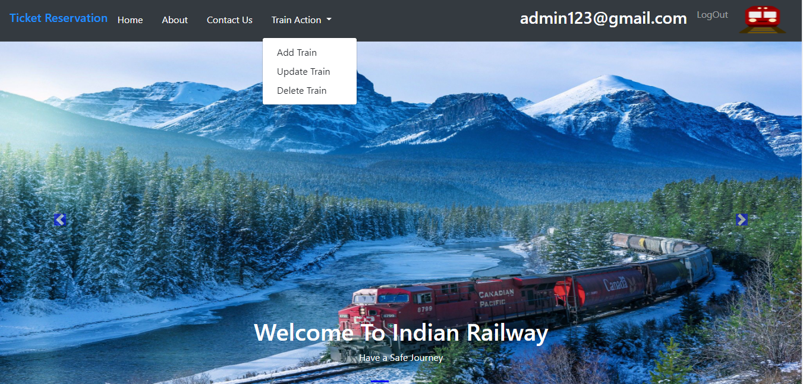
Print Page
Admin Page

Slide 12
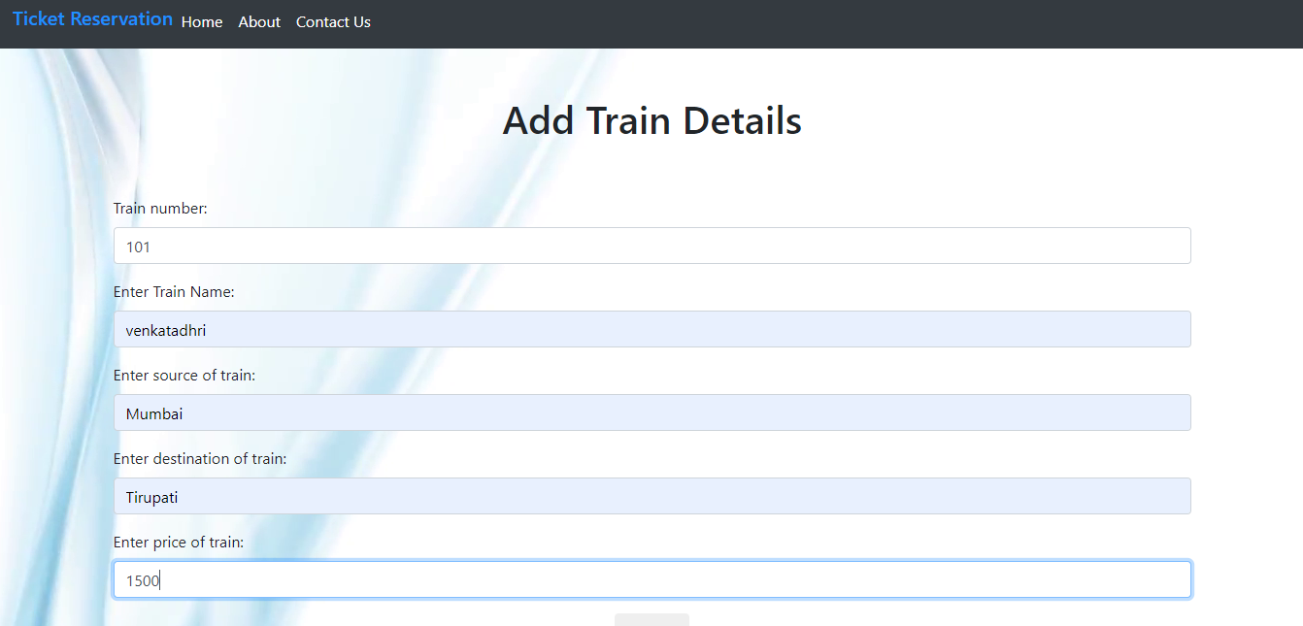
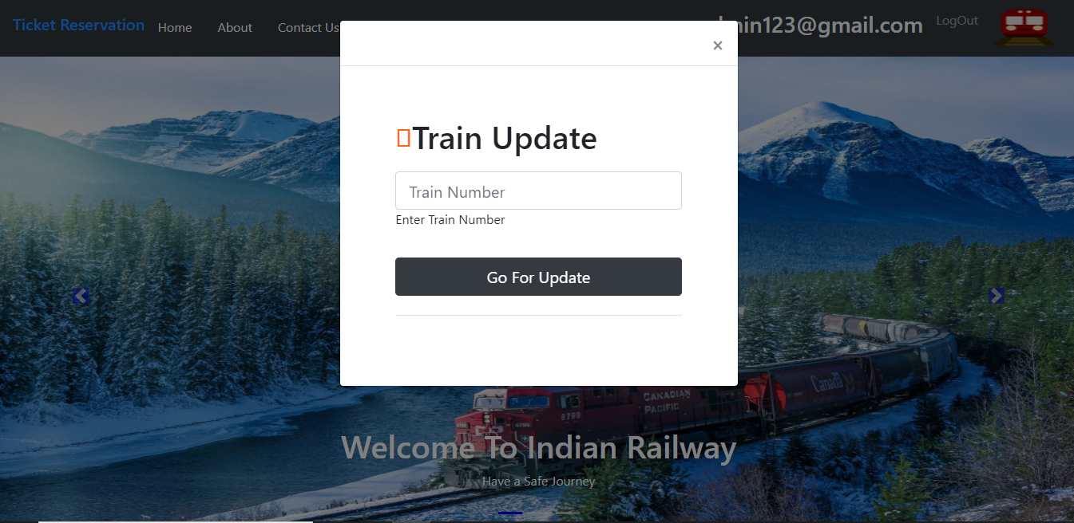
Add Train
Update Train

Slide 13
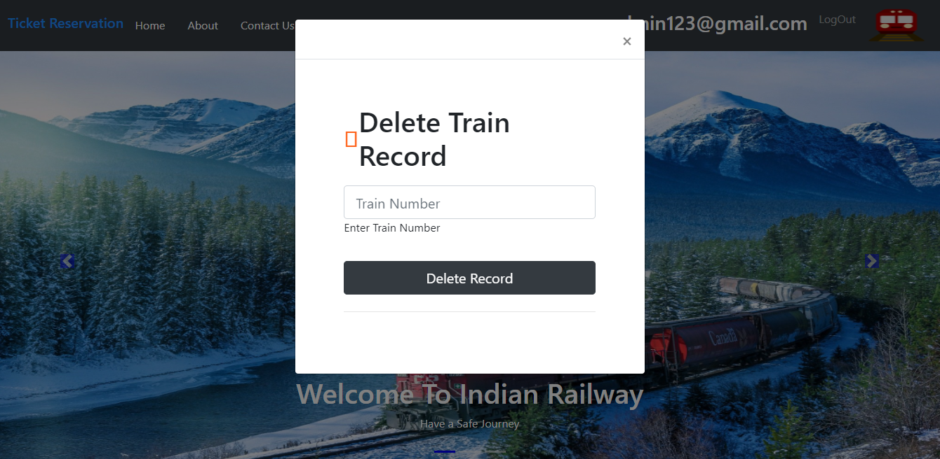
Delete Train

Slide 14
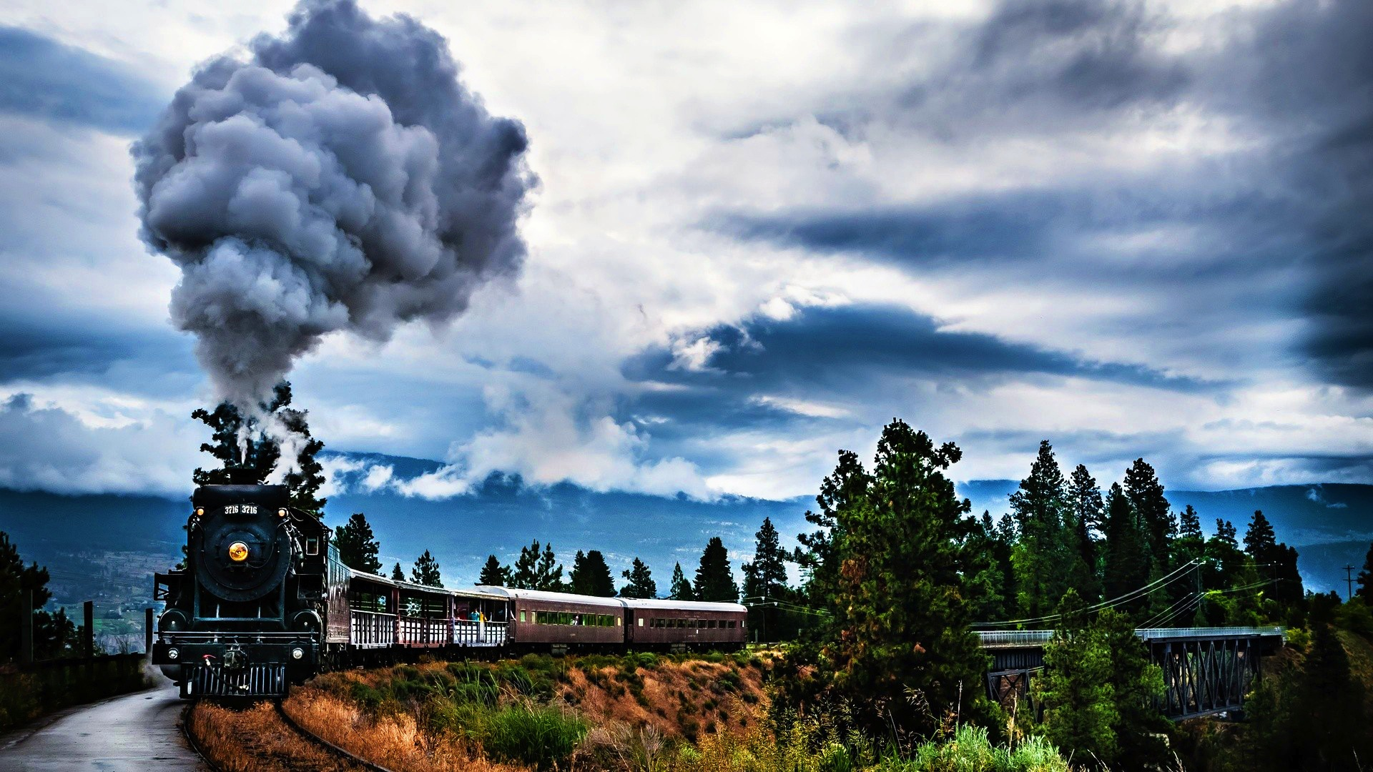
Conclusion
We finally conclude that Train reservation system mainly includes of Two modules namely Admin and user.
Admin can add, update and delete the details of list of trains available, where as user can register and login to the website by using the credentials and view the trains available and book the ticket

Slide 15
Demo

Slide 16
THANK YOU

